Slide 1



RESOLUTION:
MODEL PERFORMANCE
VS
RANDOM FOREST REGRESSOR
AWS | XGBOOST
Mean Absolute Error: 1.95
Median Absolute Error: 1.28
Mean Absolute Error: 1.66
Median Absolute Error: 1.11

Slide 2
RESOLUTION:
MODEL AND
IMPORTANT PREDICTORS
Thermal Gap
Gas
Day of the week
AWS | XGBOOST
Export of energy from Spain to France
Mean Absolute Error: 1.66
Median Absolute Error: 1.11
Wind forecast

Slide 3
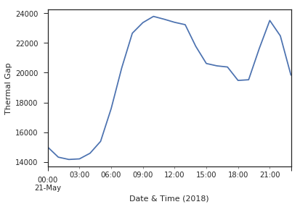
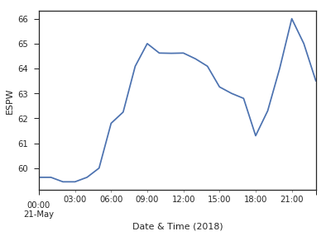
EXPLORATORY DATA ANALYSIS:
THERMAL GAP AND PRICES
Knowledge transfer from the trader was extremely helpful in this project– the predictor ‘Thermal Gap’ was very important in model accuracy.

Slide 4
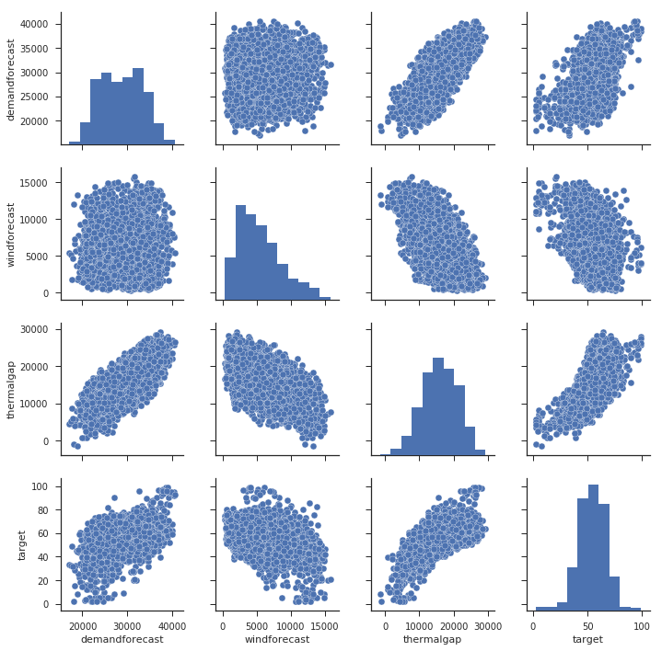
FEATURE ENGINEERING:
DATA VISUALIZATION
Historical data of different predictors and newly engineered features were plotted to look at distribution and correlation. Some of our predictors include wind forecast, demand forecast, and thermal gap.

Slide 5
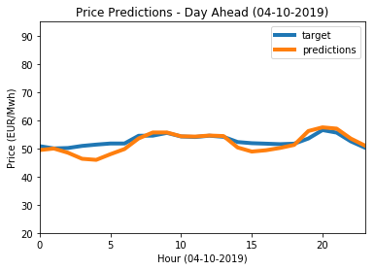
Model Output
Model output (predictions) for October 4th, 2019 compared with actual values (target).

